Slide 2
Chapter 12
Practical Database Design Methodology and Use of UML Diagrams

Slide 3
Chapter Outline
Information System Life Cycle
Phases of Database Design
UML Diagrams
Rational Rose
Other tools
Design Tools

Slide 4
Organizational Context for using Database Systems
Consolidation and integration of data across organization
Maintenance of complex data
Simplicity of developing new applications
Data independence
Protecting application programs from changes in the underlying logical organization and in the physical access paths and storage structures
External Schemas
Allow the same data to be used for multiple applications with each application having its own view of the data

Slide 5
Information System
Information System includes all resources involved in the collection, management, use and dissemination of the information resources of the organization
We consider two systems life cycles:
Macro Life Cycle
Information System Life Cycle
Micro Life Cycle
Database System Life Cycle

Slide 6
Phases of Information System Life Cycle
Feasibility Analysis
Analyzing potential application areas
Identifying the economics of information gathering and dissemination
Performing cost benefit studies
Setting up priorities among applications
Requirement Collection and Analysis
Detailed Requirements Collection
Interaction with Users
Design
Design of Database System
Design of programs that use and process the database

Slide 7
Phases of Information System Life Cycle (contd.)
Implementation
Information system is implemented
Database is loaded & its transactions are implemented and tested
Validation and Acceptance Testing
Testing against user’s requirements
Testing against performance criteria
Deployment, Operation and Maintenance
Data conversion
Training
System maintenance
Performance monitoring
Database tuning

Slide 8
Database System Life Cycle
System definition
Defining scope of database system, its users and applications
Database Design
Logical and physical design of the database system on the chosen DBMS
Database implementation
Specifying conceptual, external and internal database definitions
Creating empty database files
Implementing software applications

Slide 9
Database System Life Cycle (contd.)
Loading or data conversion
Populating the database
Application conversion
Converting applications to the new system
Testing and validation
Operation
Running the new system
Monitoring and maintenance
System maintenance
Performance monitoring

Slide 10
Database Design Process
Problem
Design the logical and physical structure of one or more databases to accommodate the information needs of the users in an organization for a defined set of applications.
Goals
Satisfy the content requirements
Provide easy structuring of information
Support processing requirements and performance objectives

Slide 11
Phases of Database Design and Implementation Process
Requirements Collections and Analysis
Conceptual Database Design
Choice of a DBMS
Data Model Mapping (Logical Database Design)
Physical Database Design
Database System Implementation and Tuning

Slide 12
Phases of Database Design and Implementation Process (contd.)
Requirements Collections and Analysis
Identifying Users
Interacting with users to gather requirements
Time consuming BUT very important
Very expensive to fix requirements error
Conceptual Database Design
Produce a conceptual schema for the database that is independent of a specific DBMS
Involves two parallel activities
Conceptual Schema Design
Transaction and Application Design

Slide 13
Conceptual Schema Design
Goal
Complete understanding of the database structure, semantics, interrelationships and constraints
Serves as a stable description of the database contents
Good understanding crucial for the users and designers
Diagrammatic description serves as an excellent communication tool

Slide 14
Desired Characteristics of Conceptual Data Model
Expressiveness
Able to distinguish different types of data, relationships and constraints
Simplicity and Understandability
Easy to understand
Minimality
Small number of distinct basic concepts
Diagrammatic Representation
Diagrammatic notation for representing conceptual schema
Formality
Formal unambiguous specification of data

Slide 15
Approaches to Conceptual Schema Design
Centralized Schema Design Approach
Also known as one-shot approach
Requirements of different applications and user groups are merged into a single set of requirements and a single schema is designed
Time consuming, places the burden on DBA to reconcile conflicts
View Integration Approach
Schema is designed for each user group or application
These schemas are then merged into a global conceptual schema during the view integration phase
More practical

Slide 16
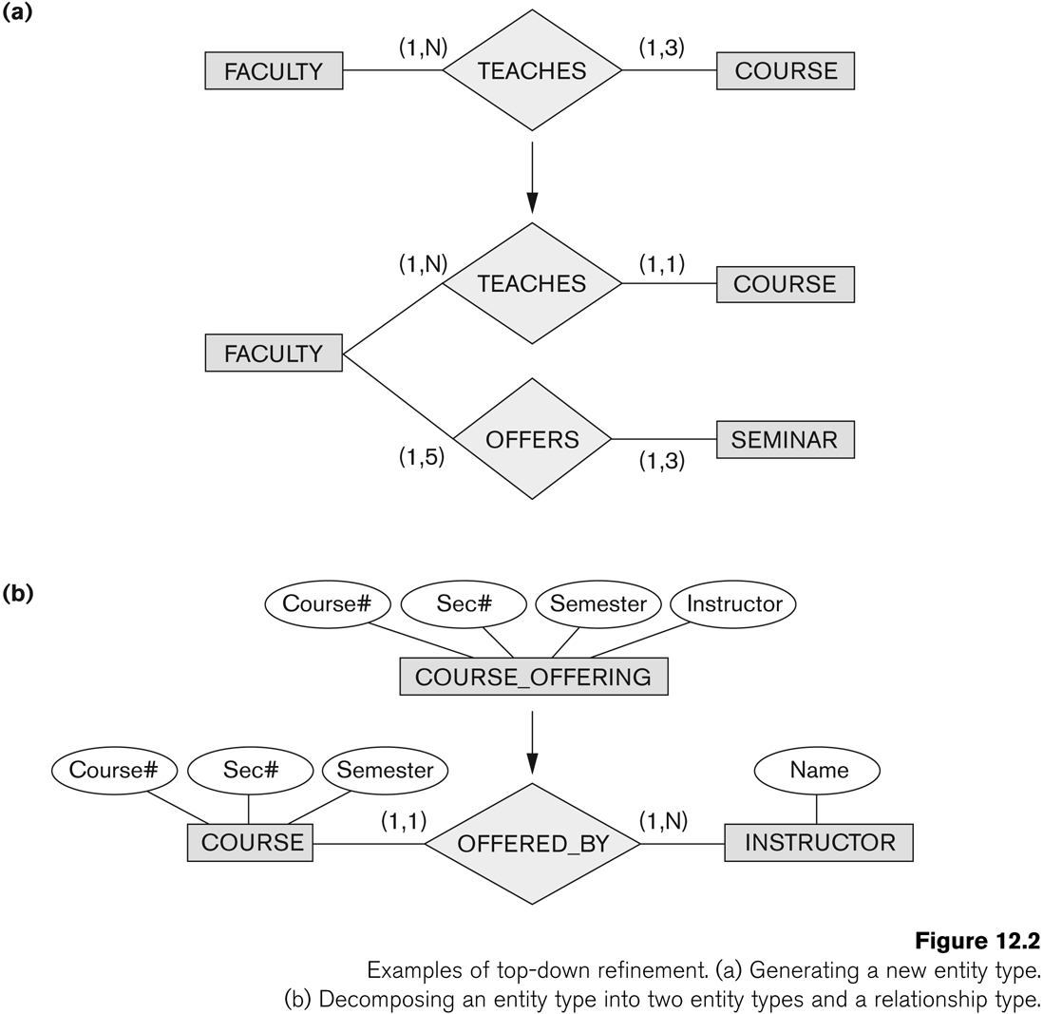
Strategies for Schema Design
Top Down Strategy
Start with a schema containing high-level abstractions and then apply successive top-down refinements

Slide 17
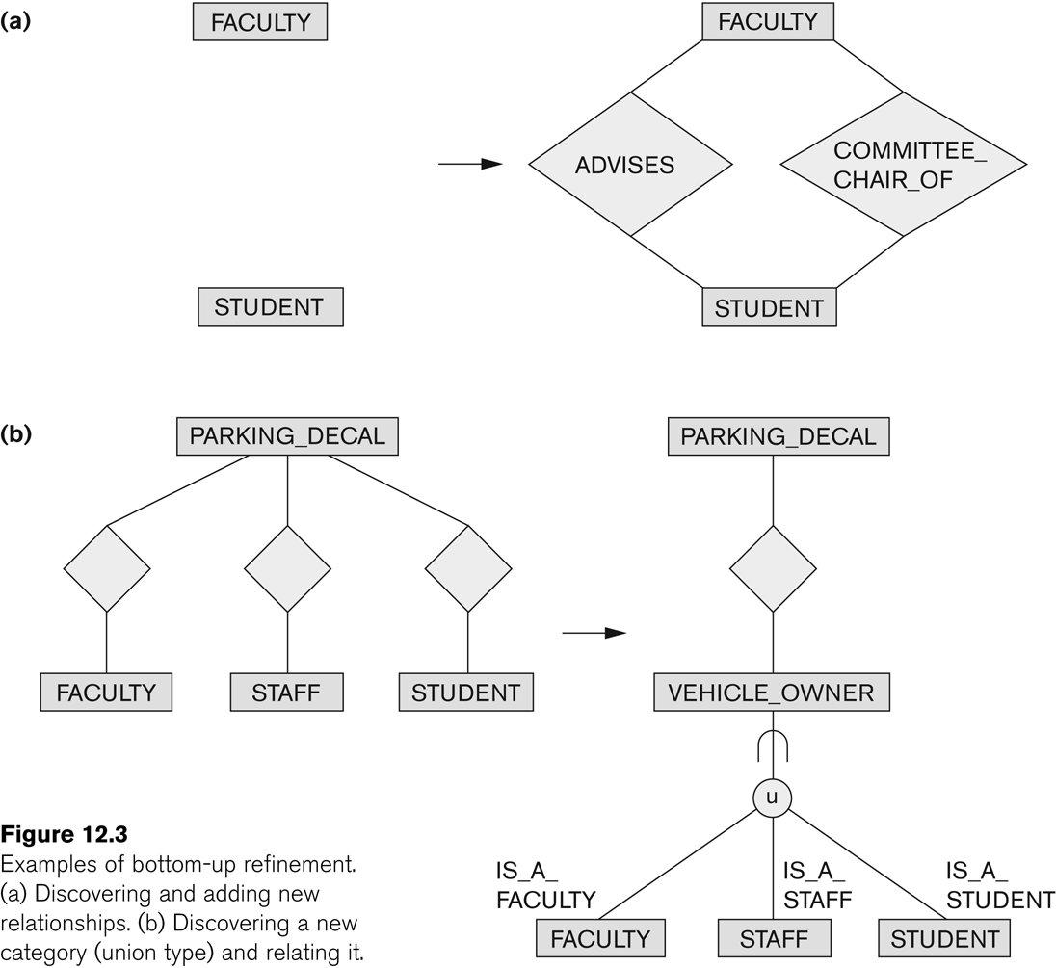
Strategies for Schema Design (contd.)
Bottom-Up Strategy
Start with a schema containing basics abstractions and then combine or add to these abstractions

Slide 18
Strategies for Schema Design (contd.)
Inside-out Strategy
Start with central set of concepts and then spread outward by considering new concepts in the vicinity of existing ones
Mixed Strategy
Use a combination of top-down and bottom-up strategies

Slide 19
Schema Integration
Identifying correspondence and conflict among different schemas
Naming conflicts
Synonyms: The same concept but different names
e.g. entity types CUSTOMER and CLIENT
Homonyms: Different concepts but same name
e.g. entity type PART as computer parts and furniture parts
Type Conflicts: Representing the same concept by different modeling constructs
e.g. DEPARTMENT may be an entity type and an attribute
Domain Conflicts: Attribute has different domains
Also known as value set conflicts
e.g. SSN as an integer and as a character string
Conflict among constraints: Two schemas impose different constraints
e.g. different key of an entity type in different schemas

Slide 20
Schema Integration (contd.)
Modifying views to conform to one another
Modifying schemas to conform to one another
Merging of views
Merging Schemas to create a global schema
Specifying mappings between views and global schema
Time consuming and difficult
Restructuring
Simplifying and restructuring to remove any redundancies

Slide 21
View Integration Strategies
Binary Ladder Integration
Two similar schemas are integrated first and the resulting schema is then integrated with another schema
The process is repeated until all schemas are integrated
N-ary Integration
All views are integrated in one procedure after analysis and specification of their correspondences
Requires computerized tools for large designs

Slide 22
View Integration Strategies (contd.)
Binary Balanced Strategy
Pairs of schemas are integrated first and the resulting schemas are then paired for further integration.
This process is repeated until a final global schema
Mixed Strategy
Schemas are partitioned into groups based on their similarity and each group is integrated separately.
This process is repeated until a final global schema

Slide 23
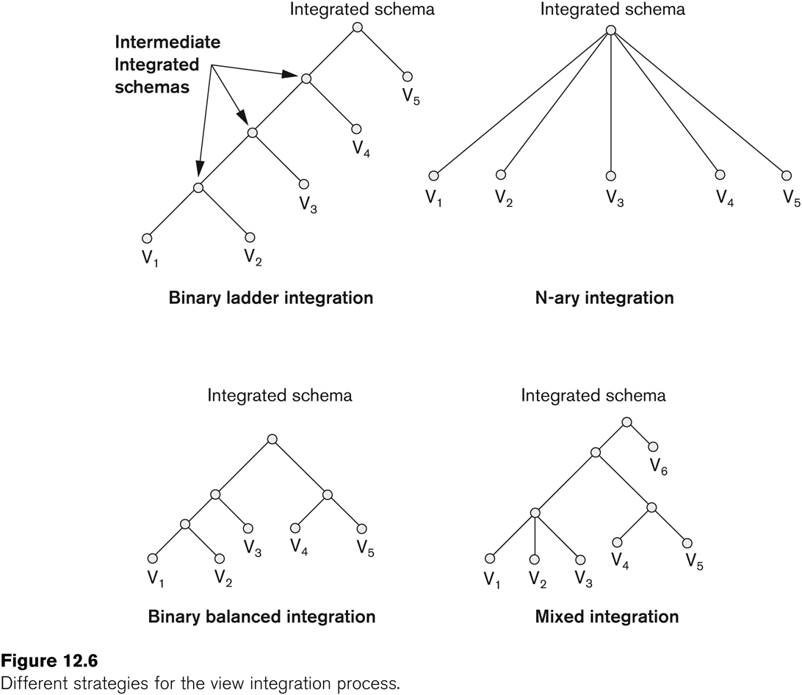
View Integration Strategies (contd.)

Slide 24
Transaction Design
Design characteristics of known database transactions in a DBMS
Types of Transactions
Retrieval Transactions
Used to retrieve data
Update Transactions
Update data
Mixed Transactions
Combination of update and retrieval
Techniques for Specifying Transactions
Input/output
Functional Behavior

Slide 25
Choice of DBMS
Many factors to consider
Technical Factors
Type of DBMS: Relational, object-relational, object etc.
Storage Structures
Architectural options
Economic Factors
Acquisition, maintenance, training and operating costs
Database creation and conversion cost
Organizational Factors
Organizational philosophy
Relational or Object Oriented
Vendor Preference
Familiarity of staff with the system
Availability of vendor services

Slide 26
Logical Database Design
Transform the Schema from high-level data model into the data model of the selected DBMS.
Design of external schemas for specific applications
Two stages
System-independent mapping
DBMS independent mapping
Tailoring the schemas to a specific DBMS
Adjusting the schemas obtained in step 1 to conform to the specific implementation features of the data model used in the selected DBMS
Result
DDL statements in the language of the chosen DBMS

Slide 27
Physical Database Design
Design the specifications for the stored database in terms of physical storage structures, record placements and indexes.
Design Criteria
Response Time
Elapsed Time between submitting a database transaction for execution and receiving a response
Space Utilization
Storage space used by database files and their access path structures
Transaction throughput
Average number of transactions/minute
Must be measured under peak conditions
Result
Initial determination of storage structures and access paths for database files

Slide 28
Database System Implementation and Tuning
During this phase database and application programs are implemented, tested and deployed
Database Tuning
System and Performance Monitoring
Data indexing
Reorganization
Tuning is a continuous process

Slide 29
UML Diagrams
Class Diagrams
Capture the static structure of the system
Represent classes, Interfaces, dependencies, generalizations and other relationships
Object Diagrams
Show a set of objects and their relationships
Component Diagrams
Show the organizations and dependencies among software components
Deployment Diagrams
Represent the distribution of components across the hardware topology

Slide 30
UML Diagrams (contd.)
Use Case Diagrams
Model the functional interactions between users and system
Describe scenarios of use
Serve as a communication tool between users and developers

Slide 31
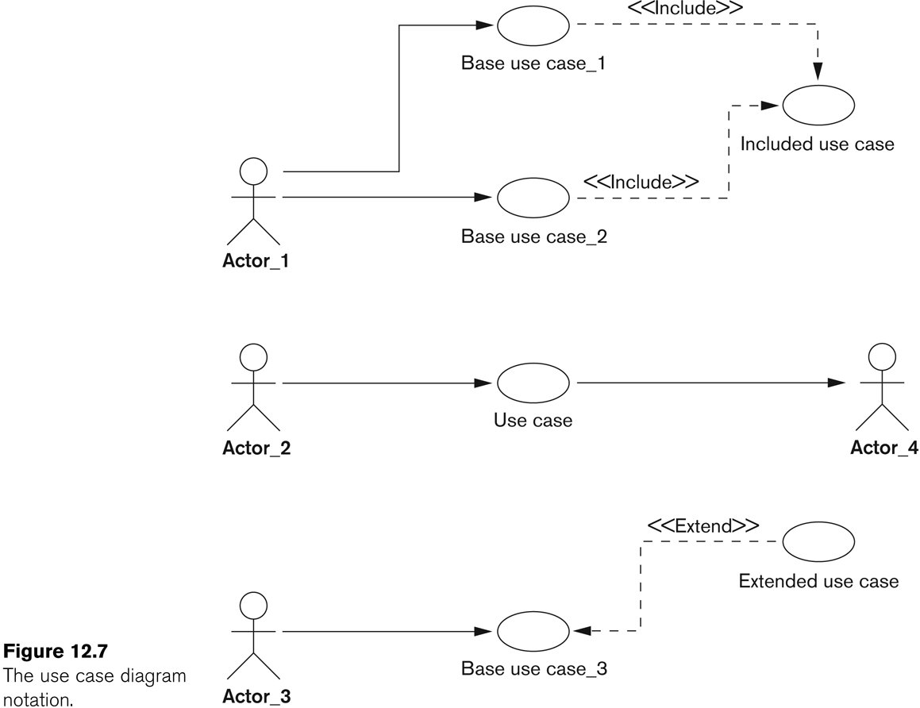
UML Diagrams (contd.)

Slide 32
UML Diagrams (contd.)
Sequence Diagrams
Represent interactions between various objects over time
Relate uses cases and class diagrams

Slide 33
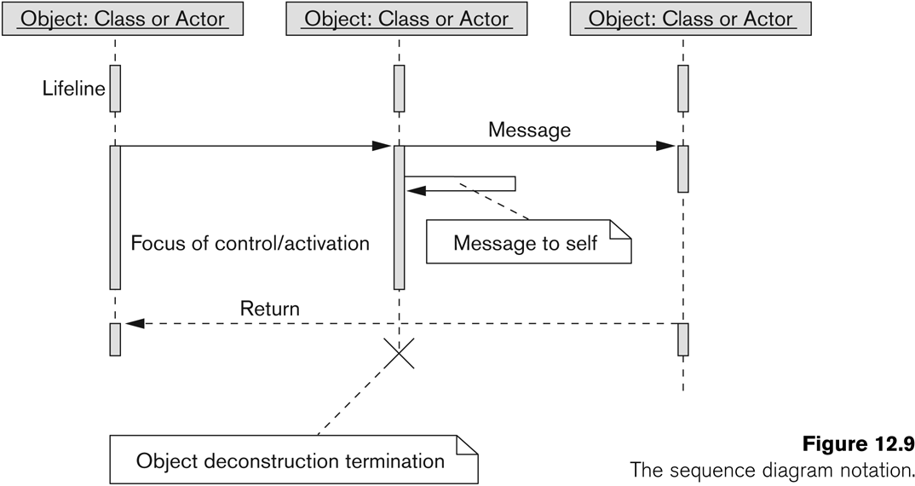
UML Diagrams (contd.)

Slide 34
UML Diagrams (contd.)
Collaboration Diagrams
Represent interactions between objects as a series of sequenced messages
Statechart Diagram
Describe how an object’s state changes in response to external events
Consist of states, transitions, actions, activities and events

Slide 35
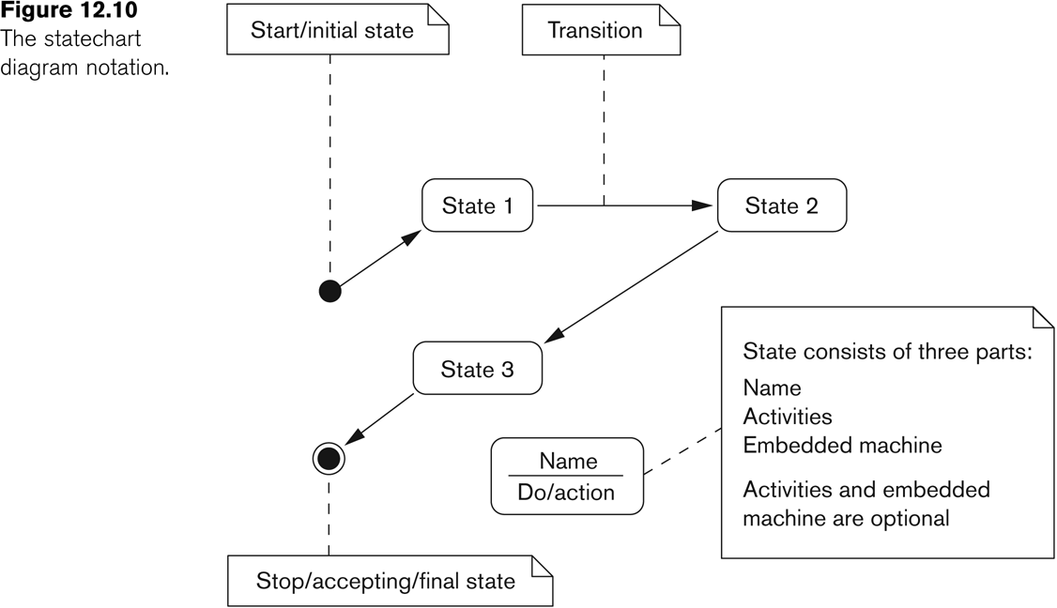
UML Diagrams (contd.)

Slide 36
UML Diagrams (contd.)
Activity Diagrams
Model the flow of control from activity to activity
Flowcharts with states

Slide 37
Salient Features of Rational Rose Data Modeler
UML based modeling tool for designing databases
Reverse Engineering
Generate a conceptual data model from an existing DBMS database or DDL
Forward Engineering
Create application/data model
Generate DDL from data model

Slide 38
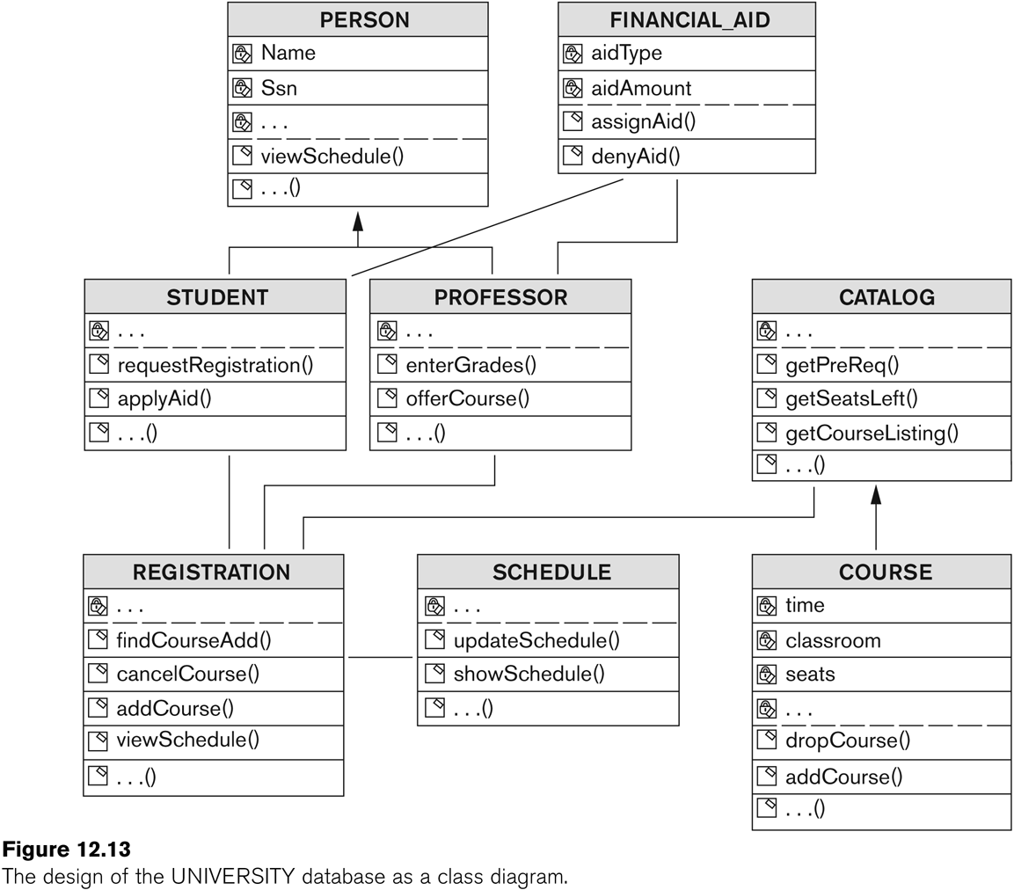
Salient Features of Rational Rose Data Modeler (contd.)

Slide 39
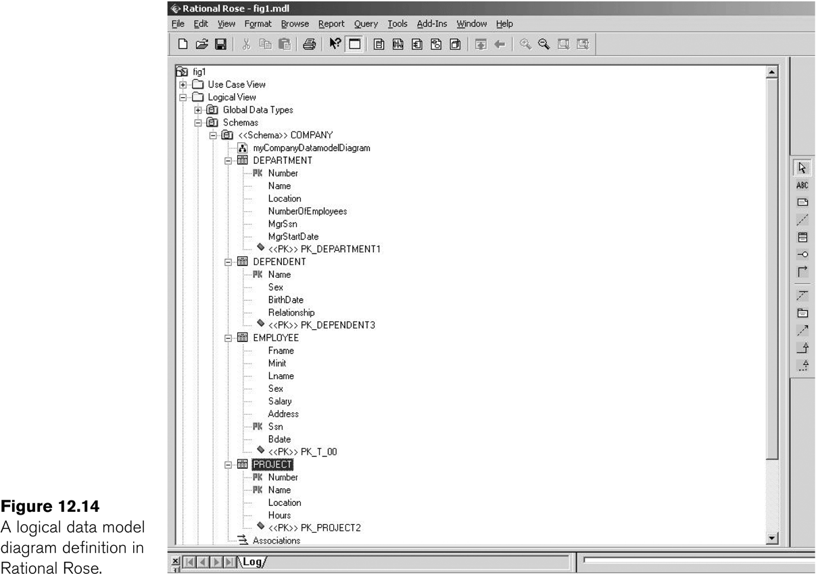
Salient Features of Rational Rose Data Modeler (contd.)
Modeling ER diagrams in UML
ER schema from the company example in chapter 3 can be drawn in Rational Rose using UML notation

Slide 40
Salient Features of Rational Rose Data Modeler (contd.)
Keeps the data model and database synchronized
Gives the option of updating the model or changing the database
Provides Extensive Domain Support
Allows database designers to create a standard set of user-defined types
Allows Converting between logical and object model design
Allows easy communication between various developing and design teams
Provides a common tool and platform to designers and developers
Rational Rose Web Publisher

Slide 41
Database Design Tools
Common Features
Allow the designer to draw conceptual schema diagram in some tool-specific notation
Allow model mapping
Allow some level of design normalization
Problems
Most tools do nothing more than representing relationships among tables
Most tools lack built-in methodology support
Most tools have poor design verification system

Slide 42
Characteristics of a Good Design Tool
Easy-to-use interface
Easy to use
Customizable
Analytical components
For difficult tasks
such as evaluating physical design alternatives or detecting conflicting constraints among views
Heuristic components
Automating design process using heuristic rules

Slide 43
Characteristics of a Good Design Tool (contd.)
Trade-off analysis
Comparative analysis in case of multiple alternatives
At least at the conceptual design level
Display of design results
Displaying results in simple and easy to understand form
Design Verification
Verifying that the resulting design satisfies the initial requirements

