Slide 1
Job Opportunities for Graduates of Computing
Prof. S. B. Junaidu
Director, Institute of Computing & ICT
Ahmadu Bello University, Zaria, Nigeria
sahalu@abu.edu.ng

Slide 2
Job Opportunities for Graduates of Computing
Opportunity Creators
Nature of Work
Skills Requirements
Job Outlook
Earnings
Summary

Slide 3
Opportunity Creators
Computing graduates find work in every industry sector
  As all businesses rely on IT to some extent
Electronic businesses are generating large volumes of data that must be stored securely, efficiently, and extracted effectively
The growth of the Internet and the expansion of the World Wide Web have generated a variety of occupations
These developments have generated a need for highly trained workers proficient in various job functions

Slide 4
Nature of Work
  Database Administrators
    Work with database management systems software and determine ways to organize, store and retrieve data
    In many cases, database administrators must integrate data from outdated systems into a new system
  Network Architects
    Design, test, and evaluate systems such as local area networks (LANs), wide area networks (WANs), the Internet, intranets, and other data communications systems
    Work with or provide solutions requiring both hardware and software systems

Slide 5
… Nature of Work
  3. Software Engineers
    Cover a variety of occupations related to the design, development, and maintenance of software artifacts
    Examples:
      Webmasters are responsible for all technical aspects of a Web site, including performance issues such as speed of access, and for approving the content of the site
      Internet developers or Web developers, also called Web designers, are responsible for day-to-day site creation and design.
  4. Theorists, researchers, or inventors
    Leverage their theoretical expertise to improve existing systems and/or create new systems/technologies/tools

Slide 6
… Nature of Work
  5. Teaching
    Potentially available at various levels
    One of the most secure and satisfying jobs, ever!
  6. Entrepreneurs
    Job creators rather than job seekers

Slide 7
Skills Requirements
  A bachelor’s degree is a prerequisite for many jobs; but some jobs may require only diplomas
  Employers look for professionals with an ever-broader background and range of skills:
    technical knowledge
    communication and,
    other interpersonal skills
  Rapidly changing technology requires an increasing level of skill and education on the part of workers in these occupations
  Jobseekers can enhance their employment opportunities by earning certifications, most of which are offered through private companies, with many related to specific products.

Slide 8
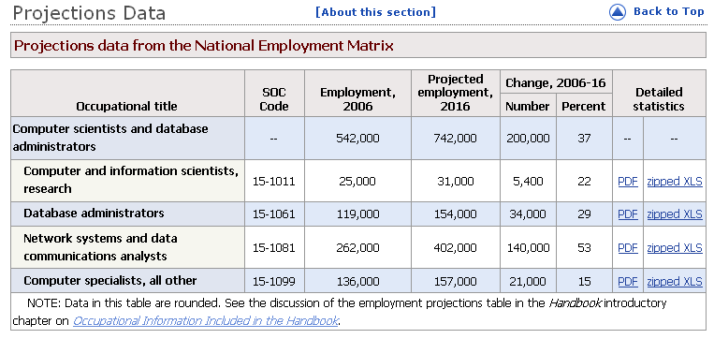
Job Outlook
Careers in computing are projected to be one of the fastest growing occupations over the next decade (http://www.bls.gov/oco/ocos042.htm):

Slide 9
Earnings
Robert Half International, a firm providing specialized staffing services, noted the following salary ranges for computer-related occupations in their 2007 Salary Guide (see http://www.bls.gov/oco/ocos042.htm ):
Database manager | $84,750 - $116,000
Network architect | 78,000 - 112,250
Database developer | 73,500 - 103,000
Senior web developer | 71,000 - 102,000
Database administrator | 70,250 - 102,000
Network manager | 68,750 - 93,000
Web developer | 54,750 - 81,500
LAN/WAN administrator | 51,000 - 71,500
Web administrator | 49,750 - 74,750
Web designer | 47,000 - 71,500
Telecommunications specialist | 47,500 - 69,500

Slide 10
Summary
  Businesses and new technologies/applications are creating job opportunities for computing specialists
  A bachelor’s degree aims to prepare graduates for a broad range of job opportunities
  Workers must be able to learn new technologies quickly for these constantly evolving occupations
  Employment is expected to increase much faster than the average as organizations continue to expand their use of technology

Slide 11
The End
Welcome to
Dialogue ICT University, Kaduna
(DICTU, Proposed)

