Slide 1
Web programming using PHP
What have we learnt?
Sending emails using PHP
Text substitution using regular expressions
Example: Extending the mailing list service to send emails
Example: Restaurant rating service
Introduction to exercises

Slide 2
Web programming using PHP
OVERVIEW:
A PHP file:
<html>
<head><title>Hello World</title>
</head>
<body>
<? echo "<b>Hello</b> ";
echo "<i>WORLD</i>";
?>
</body>
</html>

Slide 3
Until now:
Variables, numbers, strings and arrays
Computations
if-constructs and loops
Functions and code reuse
Entering user data using forms
Validating user data using regular expressions
Database access (MySQL) from PHP scripts

Slide 4
Example: Send me an email
The following service, consisting of an HTML form and a simple PHP script, allows a user to send emails to the administrator of a Web site.
The file sendmail.html:
<HTML><HEAD><TITLE>Send me an email</TITLE></HEAD>
<BODY><H2>Send me an email</H2>
<FORM METHOD=POST ACTION=sendmail.php>
<TABLE><TR><TD>Subject: <TD><INPUT NAME=subject></TR>
<TR><TD>Your email: <TD><INPUT NAME=email></TR>
<TR><TD COLSPAN=2>Message:<BR>
<TEXTAREA NAME=text COLS=30 ROWS=5></TEXTAREA></TR>
<TR><TD COLSPAN=2><INPUT TYPE=SUBMIT VALUE=Send></TR>
</TABLE></FORM></BODY> </HTML>
Note:
The file sendmail.php is action for the HTML form
Form variables that are transferred: subject, email and text

Slide 5
Example: Send me an email—continued
The recipient “mael@itu.dk” would for instance see this email:
From: gates@microsoft.com
Subject: Hi Martin
To: mael@itu.dk
Date: Thu, 18 Apr 2002 16:09:21 +0200
It is easy to send emails using PHP However, the recipient is able to detect where the email really originates:
X-From-Line: gates@microsoft.com Mon Oct 27 15:11:52 2003
Received: from tarzan ([unix socket]) (authenticated user=mael bits=0) by tarzan (Cyrus v2.1.14) with LMTP; Mon, 27 Oct 2003 15:11:53 +0100
Received: from localhost (localhost.localdomain [127.0.0.1]) by mail.itu.dk (Postfix) with ESMTP id 4459DAB954
for <mael@itu.dk>; Mon, 27 Oct 2003 15:11:53 +0100 (CET)
Received: from www.itu.dk (superman.itu.dk [130.226.133.2]) by mail.itu.dk (Postfix) with ESMTP id 9DD2CAB8CE for <mael@itu.dk>; Mon, 27 Oct 2003 15:11:52 +0100 (CET)

Slide 6
Example: Send me an email—continued
To: mael@itu.dk
Subject: Hi Martin
From: gates@microsoft.com
Message-Id: <20031027141152.98F6CA35DE@www.itu.dk>
Date: Mon, 27 Oct 2003 15:11:52 +0100 (CET)
It is easy to send emails using PHP

Slide 7
Text substitution using regular expressions
Using the PHP function ereg_replace we can replace substrings in a string with other strings.
A call to the function ereg_replace(r, d, s), returns the string s, but with the string d substituted for those substrings in s that match r.
Example: Suppose the variable $text contains the string
"Dear NAME,\nHere is some news for you, NAME:"
Then the function call
ereg_replace("NAME", "Peter", $text);
will return the string
"Dear Peter,\nHere is some news for you, Peter:"

Slide 8
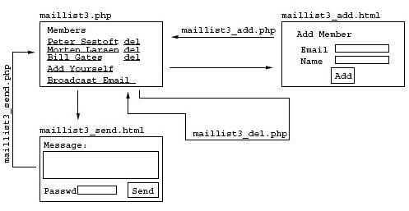
Example: Extending the mailing list example—continued
Step 3: Constructing Web forms and site maps
Step 4: Constructing PHP-files for implementing data transactions
The files maillist3.php, maillist3_send.html, maillist3_send.php, . . .

Slide 9
Extending the mailing list example—continued
The file maillist3_send.html:
<HTML><BODY>
<H2>Send Emails (version 3)</H2>
<I>Use the string <B>NAME</B> to have member’s name appear in email</I>
<P> <FORM ACTION="maillist3_send.php" METHOD=POST>Message:<BR>
<TEXTAREA NAME=text COLS=40 ROWS=5></TEXTAREA><P>
Password: <INPUT TYPE=PASSWORD NAME=passwd>
<INPUT TYPE=SUBMIT VALUE=Send>
</FORM>
<HR><A HREF="mailto:webmaster@my.com">webmaster@my.com</A>
</BODY>
</HTML>
Note:
Only users that know the password can send out email!
The form action is the file maillist3_send.php

Slide 10
Extending the mailing list example—continued
The file maillist3_send.php:
<? include("mydb.php"); // Include utilities
if ( $passwd != "hi" ) {
error("Go back and enter the correct password!");
}
if ( ereg(’^[:.0-9a-zA-ZæøåÆØÅ/,[:space:]-]+$’, $text) == 0 ) {
error("Go back and enter a valid text!");
}
mydb_connect(); // Connect to the database
$rows = mysql_query("SELECT email,name FROM maillist"); // Extract rows
while ( $row = mysql_fetch_row($rows) ) { // Iterate through the rows
$text2 = ereg_replace("NAME", $row[1], $text);
mail($row[0], "News from My.com", $text2, "From: webmaster@my.com");
echo "Message to $row[1] has been sent<P>";
} echo "<A HREF=\"maillist3.php\">Proceed</A>";
?>

Slide 11
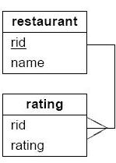
Yet another example: Restaurant rating
Step 1: Data model
CREATE TABLE restaurant (
rid int NOT NULL AUTO_INCREMENT PRIMARY KEY,
name varchar(200) NOT NULL
) TYPE=InnoDB;
CREATE TABLE rating (
rid int NOT NULL, INDEX (rid),
rating int NOT NULL,
FOREIGN KEY (rid) REFERENCES restaurant (rid)
) TYPE=InnoDB;
Step 2: Data transactions
Inserting a restaurant:
INSERT INTO restaurant (name) VALUES (’Bamboo’);
INSERT INTO restaurant (name) VALUES (’Carte Dore’);
INSERT INTO restaurant (name) VALUES (’Restaurationen’);

Slide 12
Yet another example: Restaurant rating—continued
Inserting a rating:
INSERT INTO rating (rid,rating) VALUES (1, 3);
INSERT INTO rating (rid,rating) VALUES (1, 4);
INSERT INTO rating (rid,rating) VALUES (3, 6);
INSERT INTO rating (rid,rating) VALUES (3, 5);
Step 2: Data transactions—continued
Extracting an overview—a left join with a calculation of average rating:
SELECT restaurant.rid, name, AVG(rating) AS average, COUNT(rating)
FROM restaurant LEFT JOIN rating
ON restaurant.rid = rating.rid
GROUP BY restaurant.rid, name
ORDER BY average DESC;

Slide 13
Yet another example: Restaurant rating—continued
Given the inserted data, the result of the extraction is: Without GROUP BY it would be:
FROM LTable LEFT JOIN RTable ON . . . is similar to FROM LTable, RTable WHERE . . .
LEFT JOIN includes rows in LTable that don’t match any rows in RTable, WHERE doesn’t

Slide 14
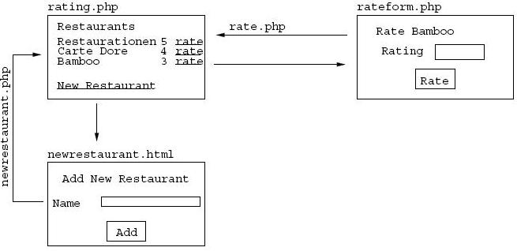
Yet another example: Restaurant rating—continued
Step 3: Constructing Web forms and site maps

Slide 15
Yet another example: Restaurant rating—continued
Step 4: Constructing PHP files—the file rating.php:
<html><body><h2>Restaurant Ratings</h2>
<table width=50%><td><b>Restaurant</b><td>Rating<td>Ratings</tr>
<? include("mydb.php"); // Inklude utilities
mydb_connect(); // Connect to database
$rows = mysql_query("SELECT restaurant.rid, name,
AVG(rating) AS average, COUNT(rating)
FROM restaurant LEFT JOIN rating
ON restaurant.rid = rating.rid
GROUP BY restaurant.rid, name
ORDER BY average DESC;");
while ( $row = mysql_fetch_row($rows) ) { echo "<TR><TD>$row[1]<TD>$row[2]<TD>$row[3]
<TD><A HREF=\"rateform.php?rid=$row[0]\">rate</A></TR>";}
?></table>
<a href="newrestaurant.html">New Restaurant</a>
</body></html>
Question: How do we display chef hats instead of a number?

Slide 16
Yet another example: Restaurant rating—continued
Step 4: Constructing PHP files—the file rateform.php
<HTML><BODY>
<? include("mydb.php"); // Include utilities
mydb_connect(); // Connect to the database
$rows = mysql_query("SELECT name FROM restaurant WHERE rid=$rid");
$row = mysql_fetch_row($rows);
echo "<H2>Rate Restaurant <I>$row[0]</I></H2>
<FORM ACTION=rate.php METHOD=POST>
<INPUT TYPE=HIDDEN NAME=rid VALUE=$rid>
Your rating:<INPUT NAME=rate><P>
<INPUT TYPE=SUBMIT VALUE=Rate>
</FORM>";
?>
</BODY></HTML>
Question:
What could we do better here?

Slide 17
Yet another example: Restaurant rating—continued
Step 4: Construction PHP files—the file rate.php
<? include("mydb.php"); // Include utilities
mydb_connect(); // Connect to the database
mysql_query("INSERT INTO rating (rid,rating)
VALUES ($rid, $rate)");
header("Location: rating.php");
?>
Question:
What could we do better here?

Slide 18
A function for generating chef hats or stars
Using recursion:
function stars($n) {
if ( $n < 1.0 ) return "";
else return ("*" . stars($n-1));
}
What is the result of the calls:
stars(3) ?
stars(5) ?
stars(4.2) ?
stars(4.8) ?
stars(-1) ?

Slide 19
Introduction to Exercise 9
During the exercise session you must construct
A Web based project market...

