Slide 1
Web programming using PHP
What have we learnt?
Underlying technologies of database supported web sites
Constructing database supported web sites
Accessing the MySQL database from PHP scripts
Example: A mailing list
auto_increment in MySQL

Slide 2
What have we learnt?
Overview:
A PHP file:
<html>
<head><title>Hello World</title>
</head>
<body>
<? echo "<b>Hello</b> ";
echo "<i>WORLD</i>";
?>
</body>
</html>

Slide 3
Until now:
Variables, numbers, strings and arrays
Computations
if-constructs and loops
Functions and code reuse
Entering user data using forms
Validating user data using regular expressions

Slide 4
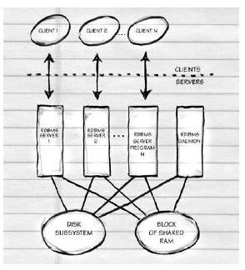
General client-server database architechture
Clients can potentially run on different
physical machines
Database processes run on the same
physical machine
One database process is established for
each client connection
Database processes are maintained by a
database daemon

Slide 5
CGI-scripts and database access (CGI = Common Gateway Interface)
Pros of CGI-scripts
All major web servers support CGI-scripts
All programming languages can be used to construct CGI-scripts
Cons of CGI-scripts
The CGI-program is started as a new operating system process each time a request arrives
Additionally, a new database server process is started for each request
The CGI-program must be authorised by the newly created database server process
It takes some time to close the CGI-program

Slide 6
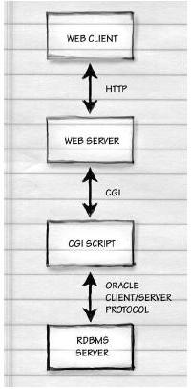
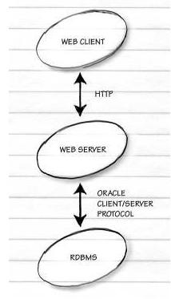
Two strategies for connecting the web server and database
Slow database connection using CGI: Fast database connection using fixed connections:

Slide 7
Web servers with fixed database connections and scripting
Pros:
Fast startup of interpreted program
Fast access to existing database connections
Cons:
Tightly connected to a specific web server—possibly non-portable

Slide 8
Java Applets
Pros:
Fast execution on the client (browser), at the expense of longer downloading time
Potential for good usability
Cons:
Safety problems—an additional open port to the database
Licensing problems—as a port for database connection must be open, typically the license paid is
proportional to the number of concurrent users
Potentially many database connections and many running database servers—when can one assume that a
database connection is no longer needed?
Is not supported or enabled on all browsers, and is problematic with PDAs

Slide 9
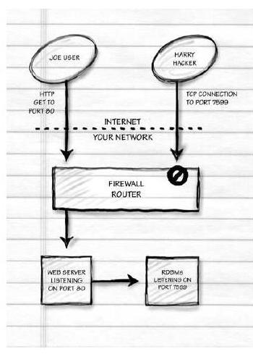
Safety
A hacker attack on data requires the following:
1. A connection to the database servers IP address
2. Password to the database server
or
1. A connection to the server’s IP address
2. A root password (by hacking the machine)
or . . .
To prevent attacks:
Move the database server behind a firewall and
allow only connections to the web server
Move the web server behind a firewall and
allow only connections via port 80

Slide 10
Constructing database supported web sites
We construct a database supported web site using the following steps:
Step 1: Constructing a data model
Which information should be stored and how should it be represented?
This is the hard part!!!
Step 2: Developing data transactions
How do we insert data into the database?
How do we extract data from the database?
Step 3: Constructing web-forms for implementing data transactions
The user interface is HTML code (forms)
Step 4: Constructing PHP-files for implementing data transactions
SQL (Structured Query Language) is used for the actual data transactions
This is the easy part!
Note: The more time you spend on Step 3, the easier Step 4 becomes!

Slide 11
Example: A mailing list
Using the mailing list system, we must be able to create a list of names and emails for distributing emails.
The same common list is maintained by all people using the system.
The only information stored are the names and email addresses.
Step 1: The data model
CREATE TABLE maillist (
email varchar(100) not null,
name varchar(100) not null
);
We assume that no two persons use the same email address, i.e., it is unique.
We insist that the name as well as the email address are present.

Slide 12
Example: A mailing list—continued
Step 3: Constructing web forms and site maps
The boxes in the diagram represent states where HTML code is displayed in a browser
Unlabelled arrows represent links to a new HTML page, possibly generated by a PHP script
Labelled arrows represent transactions that update the database by running a PHP script

Slide 13
Example: A mailing list—continued
Step 3: Constructing web forms: maillist_add.html:
<HTML>
<BODY>
<H2>Add Yourself to Mailing List</H2>
<FORM ACTION="maillist_add.php" METHOD=POST>
<TABLE>
<TR><TD>Email:<TD><INPUT NAME=email></TR>
<TR><TD>Name: <TD><INPUT NAME=name></TR>
<TR><TD COLSPAN=2><INPUT TYPE=SUBMIT VALUE=Add></TR>
</TABLE>
<HR><A HREF="mailto:webmaster@my.com">webmaster@my.com</A>
</BODY></HTML>
Note:
The file maillist_add.php is the form action
The form contains two fields called email and name

Slide 14
Example: A mailing list—continued
Step 4: Constructing PHP filer
The file maillist.php—displaying email addresses:
<HTML><BODY><H2>Mailing list members</H2><UL>
<? // Establish database connection
$db = mysql_connect("mysql.itu.dk", "W2_panic", "***");
mysql_select_db("W2_F2004_panic", $db);
// Extract rows from the table
$rows = mysql_query("SELECT email, name FROM maillist");
// Iterate through the rows
while ( $row = mysql_fetch_row($rows) ) {
// Display a single row
echo "<LI> <A HREF=\"mailto:$row[0]\">$row[1]</A>";
} ?>
<P><LI><A HREF="maillist_add.html">Add Yourself</A>
</UL><HR><A HREF="mailto:webmaster@my.com">webmaster@my.com</A>
</BODY></HTML>

Slide 15
Example: A mailing list—continued
The file maillist_add.php—adding an email address:
<? // Establish database connection
$db = mysql_connect("mysql.itu.dk", "W2_panic", "***");
mysql_select_db("W2_F2004_panic", $db);
// Insert data into the database
mysql_query("INSERT INTO maillist (email, name)
VALUES (’$email’, ’$name’)");
header("Location: maillist.php"); // Jump to maillist.php
?>
Note:
By calling the function header with location maillist.php, information is sent to the browser (via HTTP) informing it to request the file maillist.php from the server.
As this happens rapidly—and without user interaction—the result is that the updated mailing list is displayed for the user.
Are there any inconveniencies or defects in the scripts above?

Slide 16
Using an include file for establishing a connection—mydb.php
By using an include file, we avoid writing password information in all files:
<? function error ( $msg ) { echo "<HTML><BODY><H2>Error in PHP script</H2>$msg</BODY></HTML>";
exit();
}
// function for establishing connection to the database
function mydb_connect() { $dbhost = "mysql.itu.dk"; $user = "W2_panic";
$database = "W2_F2004_panic"; $passwd = "***";
$db = mysql_connect($dbhost, $user, $passwd);
if ( $db == 0 ) {
error ("Connection to database on ’$dbhost’ failed");
}
if ( mysql_select_db($database, $db) == 0 ) { error ("Failed to select database ’$user’");
}
}?>
Note: We check the return values from mysql_connect and mysql_select_db

Slide 17
Extending the mailing list example
Let us extend our mailing list example so that it is possible to remove names from the list
We consider the four steps again:
Step 1: The data model is unchanged (table maillist)
Step 2: The following data transaction is added:
Deleting email and corresponding name
DELETE FROM maillist
WHERE email = ’gates@microsoft.com’;

Slide 18
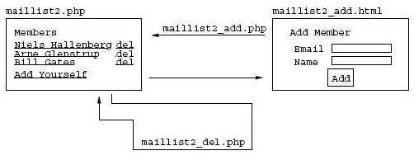
Extending the mailing list example—continued
Step 3: Constructing a site map:
The file maillist2_del.php deletes a row from the table
This file expects a form variable email, transferred in a link in the file maillist2.php: maillist2_del.php?email=gates@microsoft.com

Slide 19
Extending the mailing list example—continued
Step 4: Constructing PHP files
The file maillist2.php:
<HTML><BODY><H2>Mailing list members (version 2)</H2><UL>
<? include("mydb.php"); // Include utilities
mydb_connect(); // Connect to the database
// Extract rows from the table
$rows = mysql_query("SELECT email, name FROM maillist");
// Iterate through the rows
while ( $row = mysql_fetch_row($rows) ) {
// Display a single row
echo "<LI><A HREF=\"mailto:$row[0]\">$row[1]</A>
-- <A HREF=\"maillist2_del.php?email=$row[0]\">delete</A>";
}?>
<P><LI><A HREF="maillist2_add.html">Add Yourself</A>
</UL><HR><A HREF="mailto:webmaster@my.com">webmaster@my.com</A> </BODY>
</HTML>

Slide 20
Extending the mailing list example—continued
The file maillist2_del.php:
<?
include("mydb.php"); // Include utilities
// Check form variables
if ( ereg("[a-zA-Z][a-zA-Z.0-9-]*@[a-zA-Z.0-9-]+", $email) == 0 ) {
error("Go back and enter an email!");
}
mydb_connect(); // Connect to the database
// Delete a row
mysql_query("DELETE FROM maillist WHERE email = ’$email’");
// Jump to the main page
header("Location: maillist2.php");
?>
Note: We check that the form variable email is a valid email address
Next time: We consider among other things how to send email to the email addresses

Slide 21
Generating unique ID numbers in MySQL
In MySQL you can use auto_increment to generate fresh ID numbers automatically when inserting new rows into a table
Example:
CREATE TABLE Users (id int auto_increment primary key,
name varchar(100) not null);
INSERT INTO Users (name) VALUES (’Martin Elsman’);
INSERT INTO Users (name) VALUES (’Niels Hallenberg’);
Other database systems provide similar functionality
In PHP, to get the ID generated for an AUTO_INCREMENT column by an INSERT query, you use the mysql_insert_id function:
<?
// Insert a new row
mysql_query("INSERT INTO Users (name) VALUES (’Martin Elsman’)");
// Get the auto_increment id column
echo "Martin Elsman got ID number ".mysql_insert_id();
?>

Slide 22
Exercise
Constructing a commentary service
Add a functionality allowing the readers of your web pages to comment them. . .

