Slide 1
Database Programming with SQL
Aggregation and grouping with GROUP BY
Combination of GROUP BY and HAVING
Queries with computed fields
Left and right controlled joining: LEFT JOIN and RIGHT JOIN
Indexes and efficiency
Creating indexes (CREATE INDEX) and unique indexes
Keys
Naming tables in queries, self-joins
Which tables does the database contain?
Loading data from a file

Slide 2
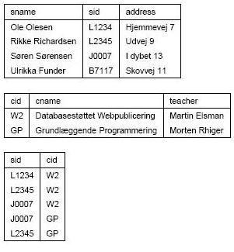
Database Programming with SQL
Example: Course data
Student:
Course:
Signup:

Slide 3
Creating tables using create table commands
CREATE TABLE Student (sname VARCHAR(80),
sid VARCHAR(10) NOT NULL,
address VARCHAR(80));
CREATE TABLE Course (cid VARCHAR(10) NOT NULL,
cname VARCHAR(80),
teacher VARCHAR(80));
CREATE TABLE Signup (sid VARCHAR(10) NOT NULL,
cid VARCHAR(10) NOT NULL);
INSERT INTO ...;
...

Slide 4
Creating tables using create table commands
Aggregated results in SELECT, renaming fields with AS, and GROUP BY
Display the total number of students signed up for courses:
SELECT COUNT(*) FROM Signup;
Fields can be named or renamed using AS:
SELECT COUNT(*) AS total_signed_up FROM Signup;
Display the number of students signed up for each course:
SELECT cid, COUNT(sid) FROM Signup
GROUP BY cid;

Slide 5
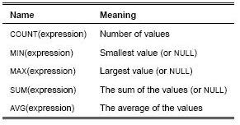
Typical aggregation functions
COUNT counts the number of non-NULL values.

Slide 6
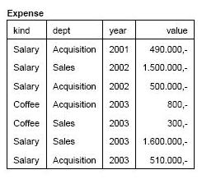
Another example: expenses in a company
CREATE TABLE Expense (kind VARCHAR(100),
dept VARCHAR(100),
year INT,
value INT);
INSERT INTO
Expense (kind, dept, year, value)
VALUES
(’Salary’, ’Acquisition’, 2001, 490000);
INSERT INTO
Expense (kind, dept, year, value)
VALUES
(’Salary’, ’Sales’, 2002, 1500000);
...

Slide 7
More aggregation and GROUP BY
Aggregation and GROUP BY can be used for generating sub totals.
Example: Total expenses grouped by department, kind, and year for the years 2002–2003:
SELECT dept, kind, year, SUM(value)
FROM Expense
WHERE 2002 <= year AND year <= 2003
GROUP BY dept, kind, year;
How do we find, for each year, the total expenses of each kind?
How do we find, for each year, the total expenses for each department?

Slide 8
Conditions in groupings
What if we don’t want (kind, department, year)-combinations where the sum of expenses is less than
1,000,000?
We cannot use WHERE SUM(value) >= 1000000.
Instead, we can add HAVING SUM(value) >= 1000000 after GROUP BY:
SELECT kind, dept, year, SUM(value)
FROM Expense
WHERE 2002 <= year AND year <= 2003
GROUP BY kind, dept, year
HAVING SUM(value) >= 1000000;
Consider the course example: How can you use GROUP BY ... HAVING construct to find the names of courses with at least 2 students?

Slide 9
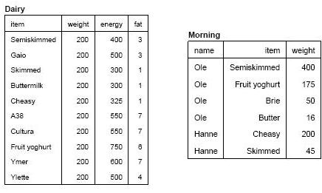
Computations in SQL-queries: A database with food and breakfast habits
The Dairy table contains item names, portion sizes (gms), energy content (kJ) and fat (gms) per portion.
The Morning table contains persons, items and quantities (gms).

Slide 10
Find the energy and fat content for each person and item
You can write simple mathematical expressions in SQL-queries:
SELECT name, Morning.item,
Morning.weight/Dairy.weight * Dairy.energy AS energy,
Morning.weight/Dairy.weight * Dairy.fat AS fat
FROM Morning, Dairy
WHERE Dairy.item = Morning.item;
Calculate the total energy- and fat intacke of each person
SELECT name,
SUM(Morning.weight/Dairy.weight * Dairy.energy) AS energy,
SUM(Morning.weight/Dairy.weight * Dairy.fat) AS fat
FROM Morning, Dairy
WHERE Dairy.item = Morning.item
GROUP BY name;

Slide 11
Find the energy and fat content for each person and item
The properties of the items and the personal data can be stored separately.
With SQL you can merge and perform calculations of the data.
It is quite cumbersome to do the same with spreadsheets.
Are there any problems with these queries?

Slide 12
Joining only includes rows with at least one match
Display the student IDs of students that have signed up for each course:
SELECT cname, sid
FROM Course, Signup
WHERE Course.cid = Signup.cid;
Or: for each course, display the number of students:
SELECT cname, COUNT(sid)
FROM Course, Signup
WHERE Course.cid = Signup.cid
GROUP BY cname;
Problem: only courses with students are shown.

Slide 13
Include all rows from the left table: LEFT JOIN
Using LEFT JOIN all rows of the left table are included, even those that do not match any rows in the right table.
SELECT Course.cname, Signup.sid
FROM Course LEFT JOIN Signup ON Course.cid = Signup.cid;
Display the number of students for each course:
SELECT cname, COUNT(sid)
FROM Course LEFT JOIN Signup ON Course.cid = Signup.cid
GROUP BY cname;
Display courses with less than two students:
SELECT cname, COUNT(sid)
FROM Course LEFT JOIN Signup ON Course.cid = Signup.cid
GROUP BY cname
HAVING COUNT(sid) < 2;
A normal join would forget courses with no students, so LEFT JOIN is important!
Correspondingly, RIGHT JOIN includes all rows from the right table, even those without a matching left table row.
LEFT JOIN and RIGHT JOIN are collectively known as OUTER JOIN.

Slide 14
How long time does a query take?
A join of two tables can take a long time to process.
Basically, each row in the one table must be matched with each row of the other.
So 10,000 rows in the one table and 10,000 in the other will require 10; 000 10; 000 = 100; 000; 000
comparisons.
This takes a long time. When Large1 and Large2 each contain 10.000 lines, the following takes 20 seconds:
SELECT id1
FROM Large1, Large2
WHERE Large1.id1 = Large2.id2.
Using indexes on id1 and id2 it takes 0.05 seconds; that is 400 times faster!
So the more lines, the more important is it to use indexes.
With 1,000,000 lines in each table, indexes will increase query speed by a factor of 15.000!

Slide 15
Primary keys
A primary key is a combination of fields that uniquely determine a row of the table.
Typically, the primary key is also the main vehicle for looking up rows of the table.
Example: sid is the primary key of Student, cid is the primary key of Course and (sid, cid) is the primary key of Signup.
You can declare the primary key when you create the table:
CREATE TABLE Student (sname VARCHAR(80),
sid VARCHAR(10) PRIMARY KEY,
address VARCHAR(80));
For multicolumn primary keys, each column must be NOT NULL and PRIMARY KEY is written just once:
CREATE TABLE Signup (sid VARCHAR(10) NOT NULL,
cid VARCHAR(10) NOT NULL,
PRIMARY KEY (sid, cid));
The following holds for primary keys:
– All columns in the primary key are automatically NOT NULL.
– A UNIQUE INDEX is automatically created on the combination of columns of the primary key.

Slide 16
Naming tables in queries, self-joins Primary keys
We would like to find all pairs of courses that are taught by the same teacher.
i.e., find all pairs (c1, c2) of courses where the teacher of c1 is identical to that of c2.
This can be done by joining the Course-table with itself (self-join).
You can name the tables in a join by writing a new name (e.g., c1) after the table name:
SELECT c1.cid, c2.cid
FROM Course c1, Course c2
WHERE c1.teacher = c2.teacher;
Add AND c1.cid < c2.cid to exclude extraneous rows.

Slide 17
Which tables does the database contain? What are their columns? Etc.
Display my tables:
SHOW TABLES;
Display the names and types of table columns:
SHOW FIELDS FROM Table;
Display the contents of a table:
SELECT * FROM Table;
Loading data into a table from a text file
You can import a text file into a table; the table must already exist.
LOAD DATA LOCAL INFILE "wwwstats.txt" INTO TABLE Weblog;

Slide 18
Exercises
Aggregated queries using SQL
Analyse a Weblog using SQL
Next time
The connection to MySQL from PHP on the Web server
Websites that are databases

